Slide 1
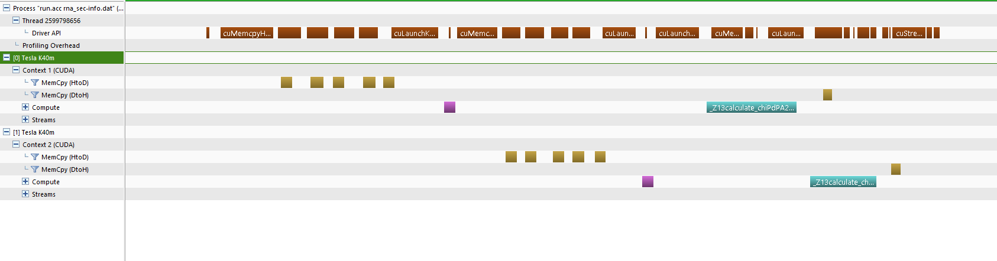
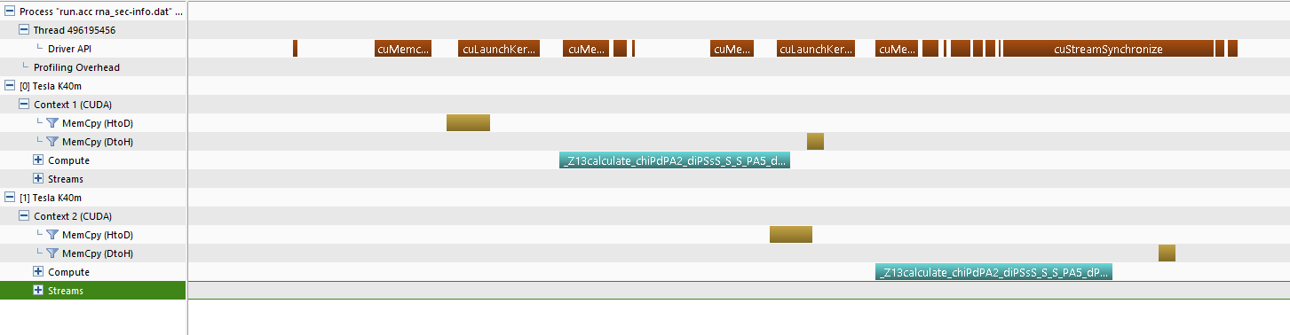

Slide 2
for (int iter = 0; iter < nadditions; ++iter) {
int j = natoms - 2 - int(sqrt(-8*iter + 4*natoms*(natoms-1)-7)/2.0 - 0.5);
int k = iter + j + 1 - nadditions + (natoms-j)*((natoms-j)-1)/2;
j++;
k++;
glob_A = scat_par_rest[i][atom_type_map_rest[j]];
glob_B = scat_par_rest[i][atom_type_map_rest[k]];
d = distances_rest[j*(natoms)+k];
scat_int_calc_gpu += 2*glob_A*glob_B*sin(scat_par_rest[i][0]*d)/
(scat_par_rest[i][0]*d);
if (k == j + 1) {
scat_int_calc_gpu +=glob_A*glob_A;
}
}

Slide 3
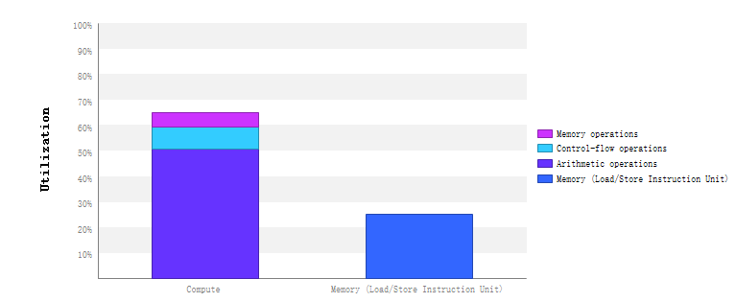

Slide 4
openacc, 42, K40 | K20X
cuda | 46.5
smem for scat_par_rest | 42.5
smem for atom_type_map | 34
LDG for distances | 39.4
L1 for distances | 34.3
sinf | 27
sqrtf | 25.3
"f" for index formula | 24.7
LDG for distances | 23.4
"ftz,prec-sqrt,prec-div" | 23
Apply “sinf & sqrtf” to OpenACC, 42 ms => 34 ms
“Cache”: parse invalid cast opcode for cast from “i32” to “double”

Slide 5
for (int iter = threadIdx.x; iter < nadditions; iter += blockDim.x) {
int j = natoms - 2 - int(sqrtf((float)(-8*iter + 4*natoms*(natoms-1)-7))/2.0f - 0.5f);
int k = iter + j + 1 - nadditions + (natoms-j)*((natoms-j)-1)/2;
j++;
k++;
glob_A = s_scat_par_rest[s_atom_type_map_rest[j]];
glob_B = s_scat_par_rest[s_atom_type_map_rest[k]];
d = __ldg(&distances_rest[j*(natoms)+k]);
scat_int_calc_gpu += 2.0*glob_A*glob_B*sinf((float)s_scat_par_rest[0]*d)/
(s_scat_par_rest[0]*d);
if (k == j + 1) {
scat_int_calc_gpu += glob_A*glob_A;
}
}

